Slide 1


MSC3182
SOCIAL ENTREPRENEURSHIP
Lesson 1
SELF DISCOVERY

Slide 2
FLOW
Childhood passion became a basic idea for a successful businessman.
Interest and passion will reflect in the business setup.
There are certain things that we deeply love and enjoy doing.
Area of interest or passion which consumes them completely.
It is an interest that they pursue on their own, and enjoy doing so.
This area of passion is known as “FLOW”

Slide 3
WHEN A PERSON IS SAID TO BE IN A STATE OFLOW
Do something they love
Lose track of time and immersed in what they are doing.
Have the requisite talent/skills to do this.
Take the initiative; you do not need to be pushed to do this.
Grab every opportunity in this area to improve your skill levels.
Even if the activity is challenging, you enjoy taking up the challenge.
Flow is not leisure activity which you do in order to relax or take a break from serious work

Slide 4
MSC3182
SOCIAL ENTREPRENEURSHIP
Lesson 1
EFFECTUATION PRINCIPLE

Slide 5
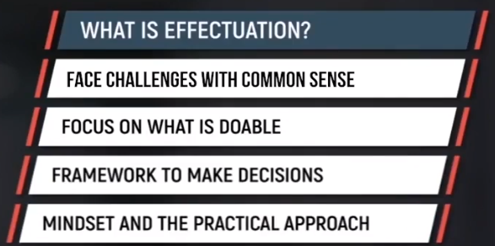
EFFECTUATION – entrepreneurial thought process
Effectuation is a set of common sense principles that help you face challenges with common sense and focus on what is doable.

Slide 6
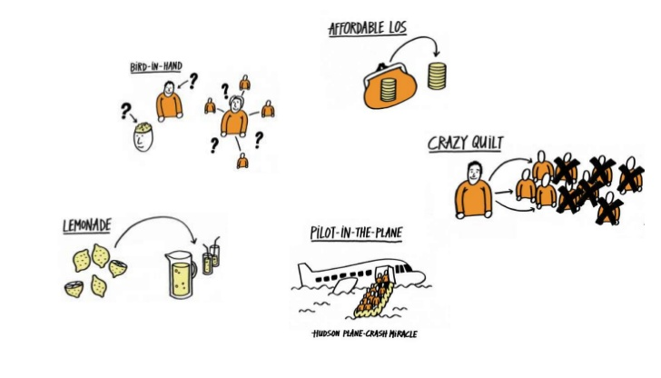
EFFECTUATION – entrepreneurial thought process
https://www.slideshare.net/Tblekman/corporate-effectuation-slideshare

Slide 7
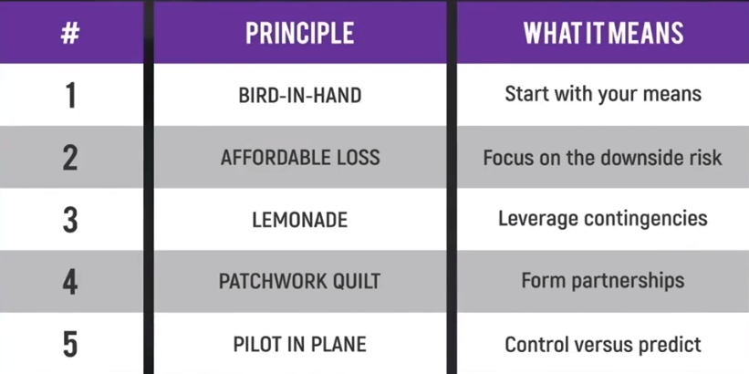
EFFECTUATION PRINCIPLE

Slide 8


BIRD IN HAND

Slide 9


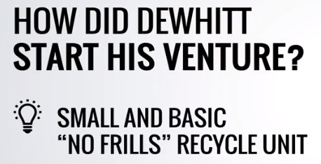

AFFORDABLE LOSS
He asked a simple question before he start the business. How much money he could spend and how much more to invest.

Slide 10


EFFECTUATION PRINCIPLE

Slide 11
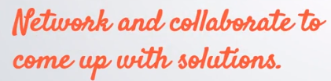
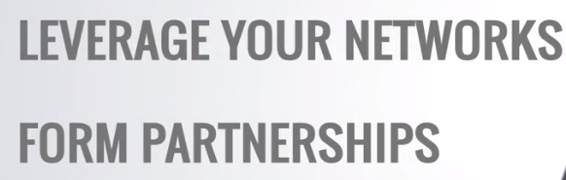


EFFECTUATION PRINCIPLE

Slide 12


EFFECTUATION PRINCIPLE

